Slide 1
CASE STUDY 2 – MSDS 6306
Jonathan Flores, Melissa Luzardo and Randy Park

Slide 2

DDS Analytics – “Attrition” Predictive Model
Project Description:
DDS executive leadership has identified predicting employee turnover as its first application of data science for talent management.
Request:
The team is tasked our data science team to conduct an analysis of existing employee data.
GitHub Repository
https://github.com/cyberkoolman/msds.6306.case.study.2

Slide 3
Methodology and framework used to study attrition
Cross Validation
Model Creation
Exploratory Data Analysis
Explore: Attrition vs All Variables
Try to find important variables and relevant trends
Clean and transform the information to a numeric data set
Evaluate Prediction Models against requirements
Split data set into training and data set
Create model and Reduced Model
Create Predictions using testing data set
Cross validation with testing data set
Study Results

Slide 4
EXPLORATORY DATA ANALYSIS
Includes some relevant variables – for more detailed information, please visit the git hub repository

Slide 5
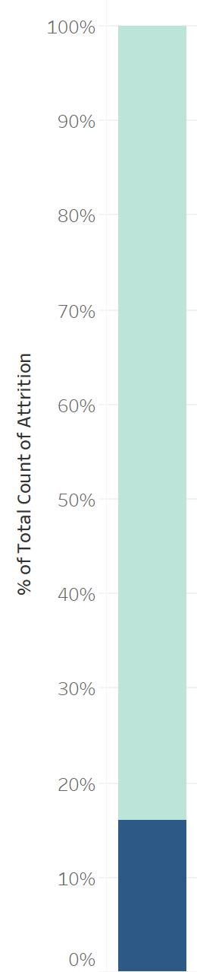
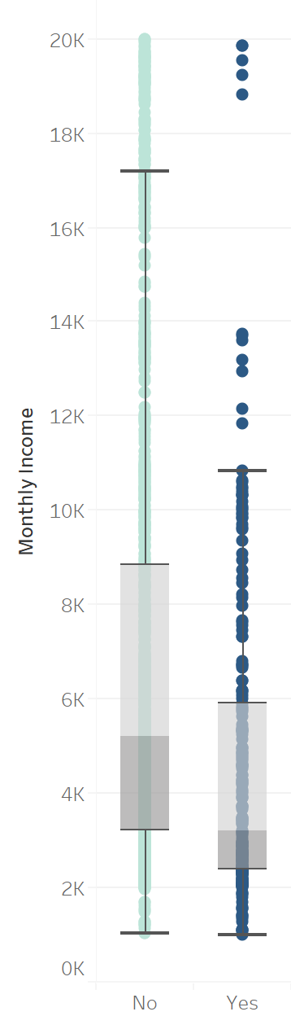
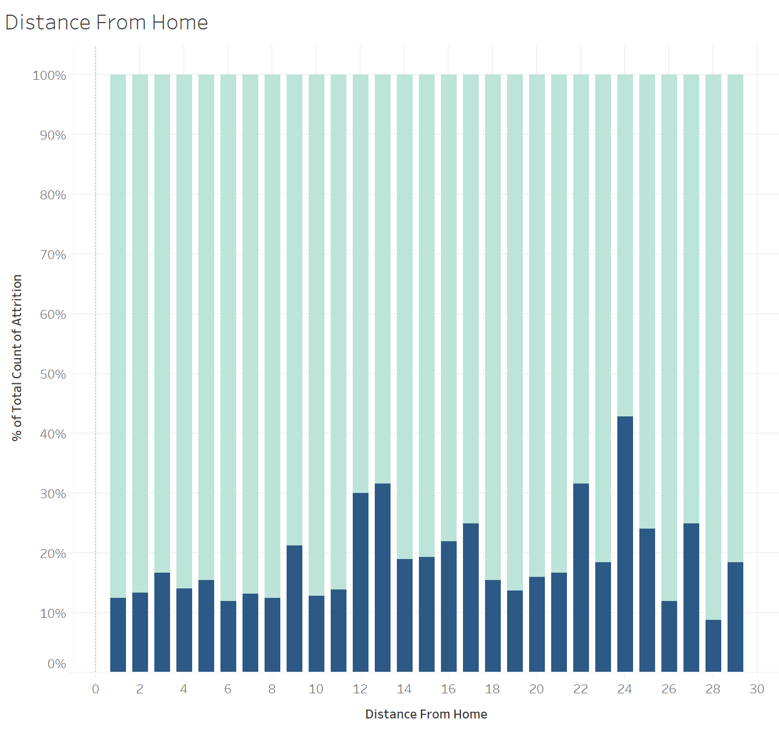
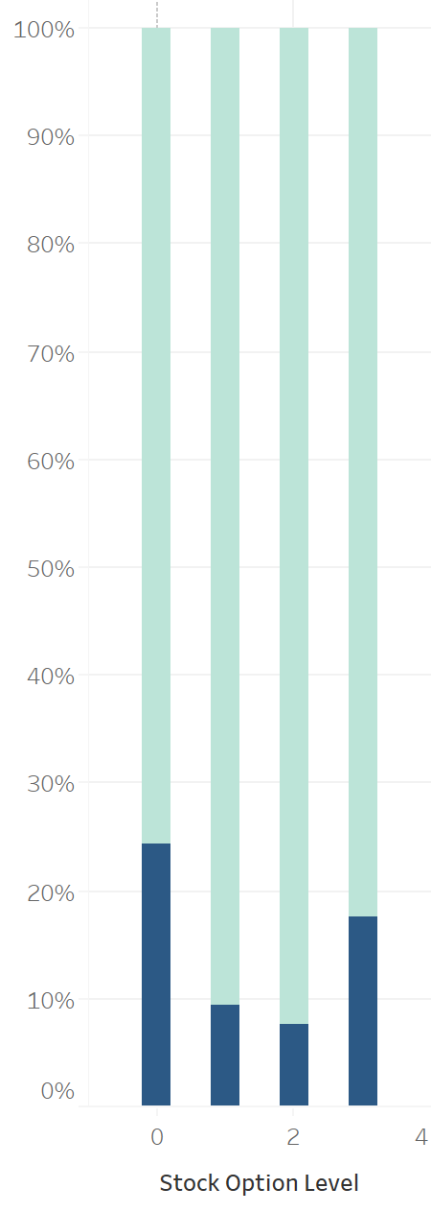
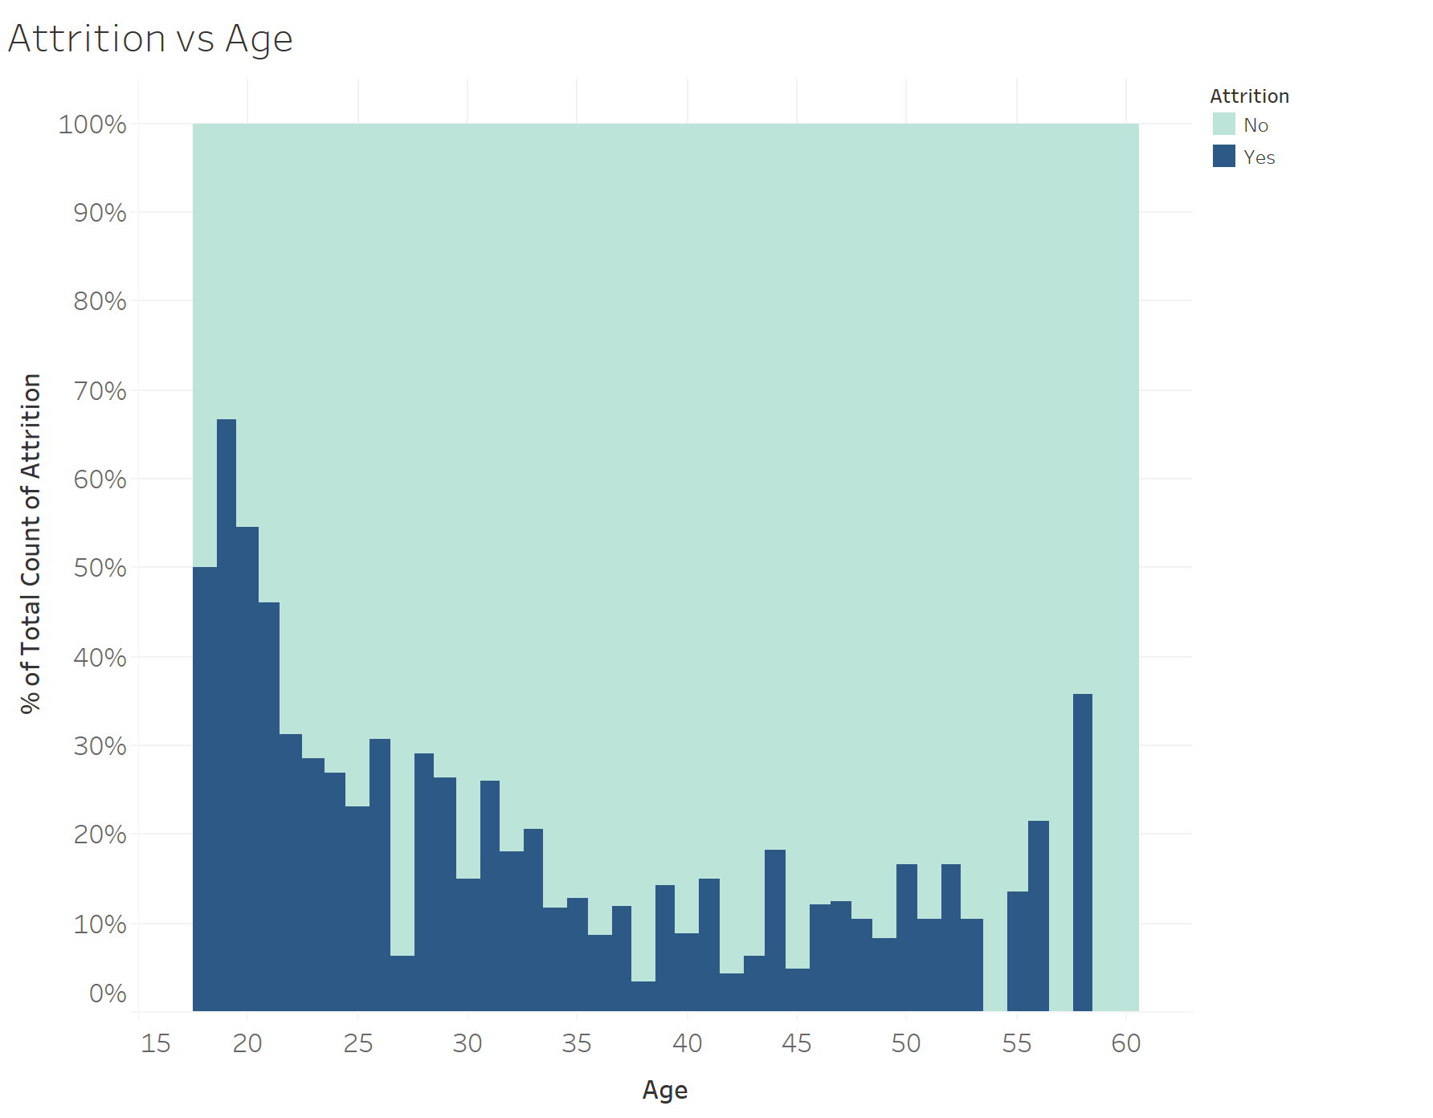
Attrition by: income, distance from home and stock option levels
Attrition
Monthly Income
Distance From Home
Stock Option Level
Attrition seems to be more likely to happen with employees with lower monthly incomes
12, 13, 22, and 24 miles from home seem to have higher percentages than the rest. Closer to home has lower percentages of attrition
Not much significant attrition difference between stock option levels
Attrition is at 16%

Slide 6
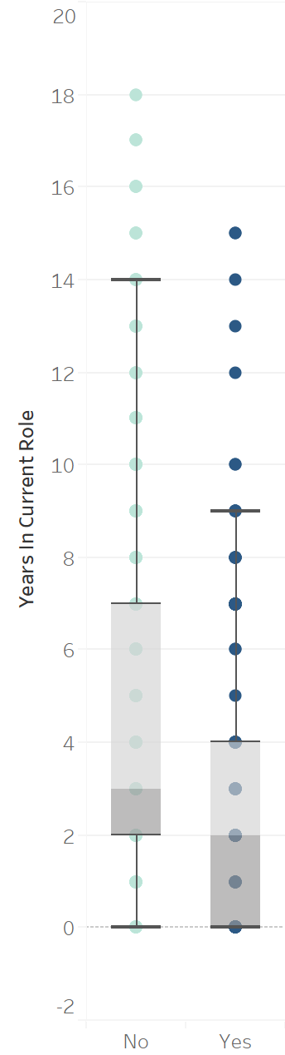
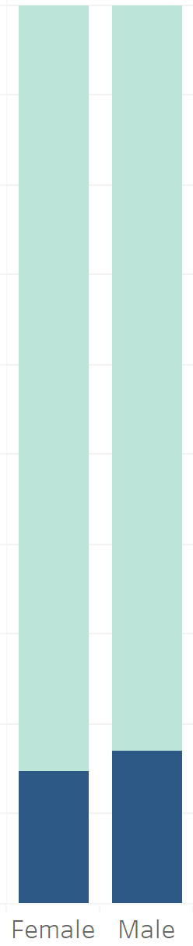
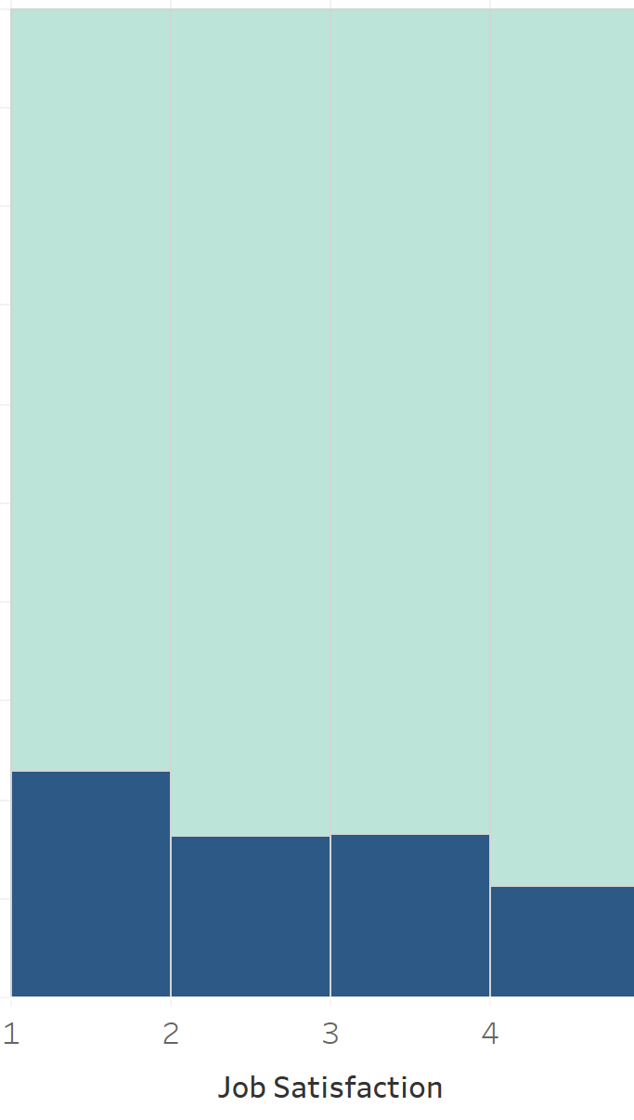
Attrition by: Age, gender, Job Satisfaction and years in a role
Age
Gender
Job Satisfaction
Years in Current Role
Employees in the ages from 18 to 21 tend to quit their job more than employees in different ages
Not much attrition difference. F: 14.8% and M:17%
Not much attrition difference between Job Satisfaction Levels
75% of attrition occurs on employees with less than 4 years in current role

Slide 7
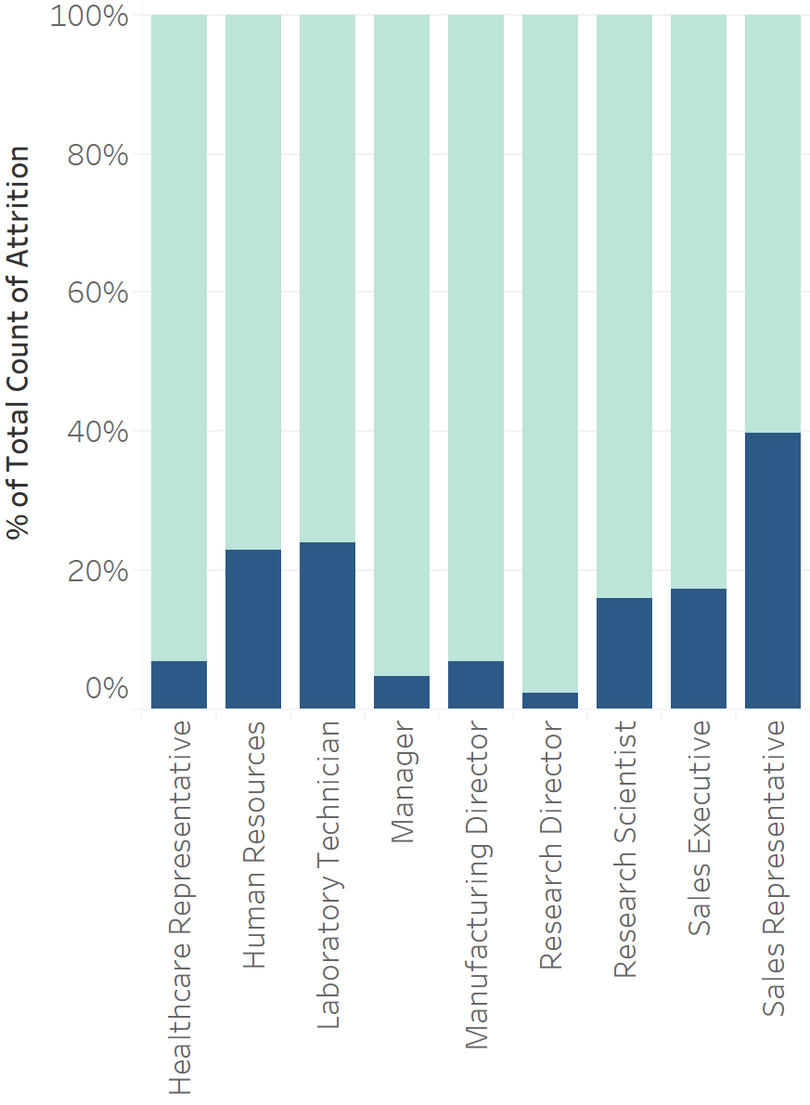
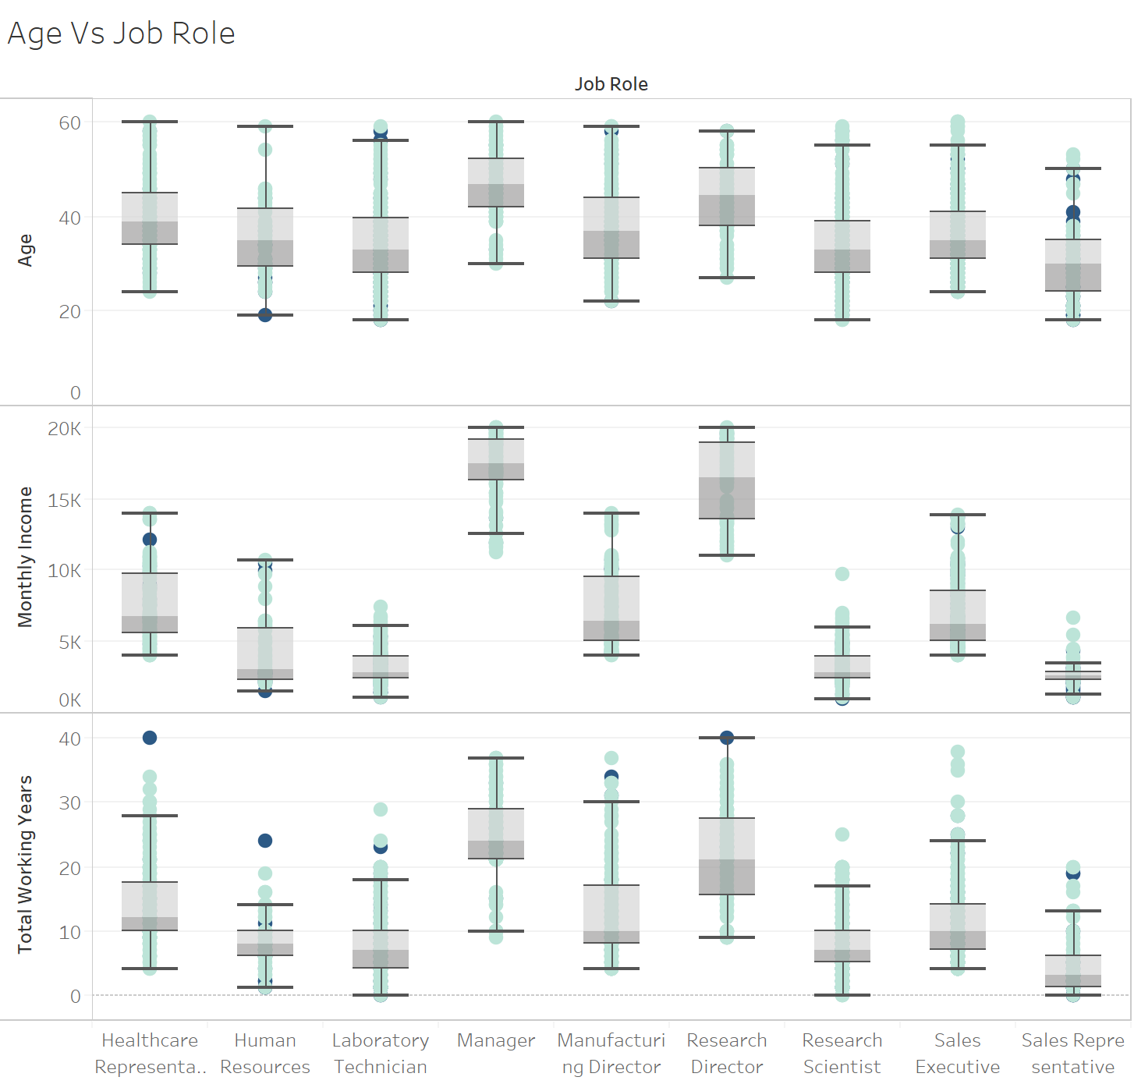
Job roles vs attrition, age, income and working years
Age / Job Role / Attrition
Sales representative have the highest attrition at 40%. Then HR and Lab Tech. at 23% and 24% respectively
All job roles have a similar age range
There is no a specific pattern between Age, Job Role and Attrition
Income / Job Role / Attrition
Sales Reps, Lab Tech and Research Scientist are the lowest paid, which may explain the high attrition in this specific job role
Job Roles with highest income have low attrition rates (e.g. Manager, Research Director)
Working Years / Job Role / Attrition
Irrespective of Job Role, it is expected for people to retire. After ~23 of working years

Slide 8
Model creation and cross validation

Slide 9
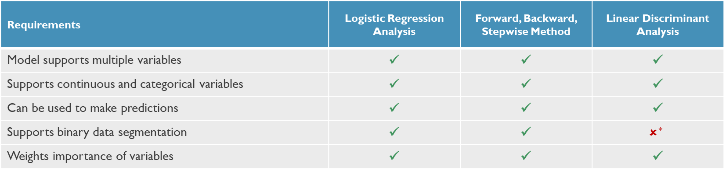
model importance, Requirements and model evaluation
Importance of attrition predictive model
The predictive model combines insight from all the variables to make a more robust prediction than if using single variables
Identifies the most significant variables in the context of prediction
Evaluated Models
Selected
Requirements | Logistic Regression Analysis | Forward, Backward, Stepwise Method | Linear Discriminant Analysis
Model supports multiple variables | ✓ | ✓ | ✓
Supports continuous and categorical variables | ✓ | ✓ | ✓
Can be used to make predictions | ✓ | ✓ | ✓
Supports binary data segmentation | ✓ | ✓ | $$✗^{∗}$$
Weights importance of variables | ✓ | ✓ | ✓
*It is possible to use LDA model for binary predictions; however, LDA is best suited for more than two categorical predictions
Notes:
All models can predict attrition given our data set. Selected the logistic regression analysis.
Both LRA and F/B/S methods are probability models. Only LDA is a machine learning model

Slide 10
Logistic Regression analysis – final Reduced model
With this model, new employees data with respective profile can be introduced and the model will output an attrition probability for each employee
Final Attrition Model
Reduced LRA Model
Variable (1 of 2) | Estimate | Probability
Over Time - Yes | 2.002 | 7.59E-21
Job Satisfaction - 4 | -1.441 | 8.06E-07
Marital Status - Single | 1.456 | 1.39E-06
Environment Satisfaction - 4 | -1.267 | 6.61E-06
Years Since Last Promotion | 0.2028 | 3.15E-05
Distance From Home | 0.04841 | 4.23E-05
Job Role Sales Representative | 2.195 | 7.01E-05
Environment Satisfaction - 3 | -0.9925 | 0.0002872
Environment Satisfaction – 2 | -1.101 | 0.0004351
Job Role Laboratory Technician | 1.679 | 0.0004873
Job Involvement – 4 | -1.743 | 0.000664
Job Involvement – 3 | -1.223 | 0.001263
Training Times Last Year | -0.2507 | 0.001918
Job Involvement – 2 | -1.22 | 0.002915
Job Role Human Resources | 1.803 | 0.003652
Relationship Satisfaction – 4 | -0.808 | 0.004164
Job Role Sales Executive | 1.323 | 0.005139
Variable (2 of 2) | Estimate | Probability
Years With Curr. Manager | -0.1448 | 0.005414
Work Life Balance – 3 | -1.111 | 0.00638
Years In Current Role | -0.1422 | 0.006733
Relationship Satisfaction – 2 | -0.8518 | 0.007649
Relationship Satisfaction – 3 | -0.7248 | 0.009146
Job Satisfaction – 3 | -0.685 | 0.01102
Num Companies Worked | 0.1071 | 0.01271
Job Role Research Scientist | 0.7686 | 0.1126
Job Satisfaction – 2 | -0.4199 | 0.159
Work Life Balance - 2 | -0.5628 | 0.1929
Work Life Balance – 4 | -0.625 | 0.202
Marital Status Married | 0.3468 | 0.2368
Years At Company | 0.02915 | 0.4699
Job Role Research Director | -0.5145 | 0.5693
Job Role Manufacturing Director | 0.269 | 0.6412
Intercept | 0.3174 | 0.7546
Job Role Manager | -0.1384 | 0.8604
Other Model Insights
Variables are ordered by how statistically significant they are. High to Low*
The lower the probability of a variable within the model, the higher statistically significant the variable is, in the context of the model
Final Reduced Model AIC is 841, improved from original full model’s AIC of 853
The model was created based on a ‘training’ data split. Cross validation was performed on the ‘testing’ data split

Slide 11
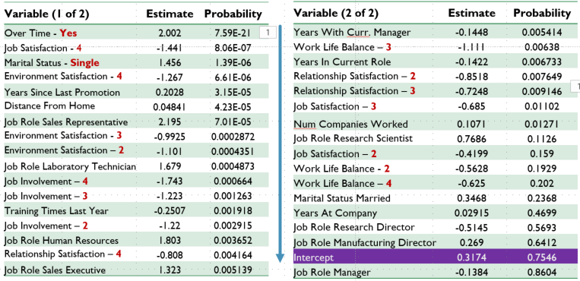
Cross validation and model results
LRM
Split
EmpID | Attrition Probability | Attrition Interpretation
1 | 30% | No
2 | 75% | Yes
...147 | 20% | No
Full Data Set
1,470 Obs.
Training
1,323 Obs.
(90%)
Cross Validation
Examples of Results
87% Accuracy
Testing
147 Obs.
(10%)
 | Correct | Misclassified | Total
NO | 114 | 6 | 120
YES | 14 | 13 | 27
Totals |  |  | 147
Accuracy Results – Compared to Actuals

Slide 12
Attrition - Conclusion and summary
Analysis Repository
Data Set
Data set contains 32 variables (including attrition)
Prediction Model
87% accuracy when cross validation was performed
The most statistically significant variables in the model are: Over Time – Yes, Job Satisfaction – 4, Marital Status – Single, Environment Satisfaction - 4, Years Since Last Promotion
1,470 observations
The data set contains discrete, continuous and categorical variables
Logistic Regression Model met all the data set requirements
Insights
The most highly correlated variables (absolutes), according to ‘Pearson’s correlation”, with Attrition are: Overtime, Total working years and Job Level
Attrition was calculated at 16% for the entire company
17 variables are categorical
Sales Reps, Lab Tech and Research Scientist are the lowest paid, which may explain the high attrition in these specific job roles
Larger attrition in younger employees than older employees

